Slide 1
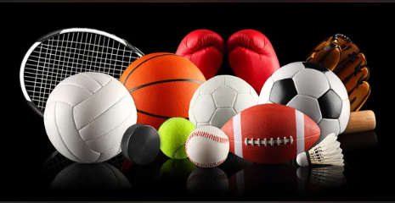
GoodSports Goods
Play with Passion

Slide 2

Team Members
Sai Chand
Abhitej (Scrum Master)
Hetal (Product Owner)
Aabha
Chris
Pavan Kalyan
Pavan
Manasa

Slide 3

Our activity
Business Requirements
Scope and Limitations
Business Context

Slide 4
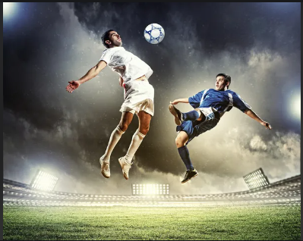
Background
The sports-related business, whether it may be sports goods or merchandise related to it, has been a booming business since the day it started.
Sports-related instruments, gear, and clothes have been highly desired by people.
Customers also want to customize the merchandise they buy.
This website is a combination of both, where they can buy goods and also create their own products.
This website creates a feeling in the customers that they have created their own products, such as seeing people’s names on the sports jersey of their favorite team.

Slide 5

We will use the demand for sports products and sports-related merchandise as a starting point. People who want to customize their sports products are high. The company will not only focus on selling sport-related products but will also allow customers to customize products, thereby fulfilling the demand.
We see a lot of e-commerce websites selling sport-related products, but what separates this from them is the ability to choose the product and then make changes to the product in the way the particular customer wants to and satisfy them with the quality of the product.
Websites nowadays sell products online without checking the quality. Many of these customers only get to see the seller’s information and are unable to contact them. Our service allows customers to communicate with previous customers and know their feedback directly before buying.

Slide 6
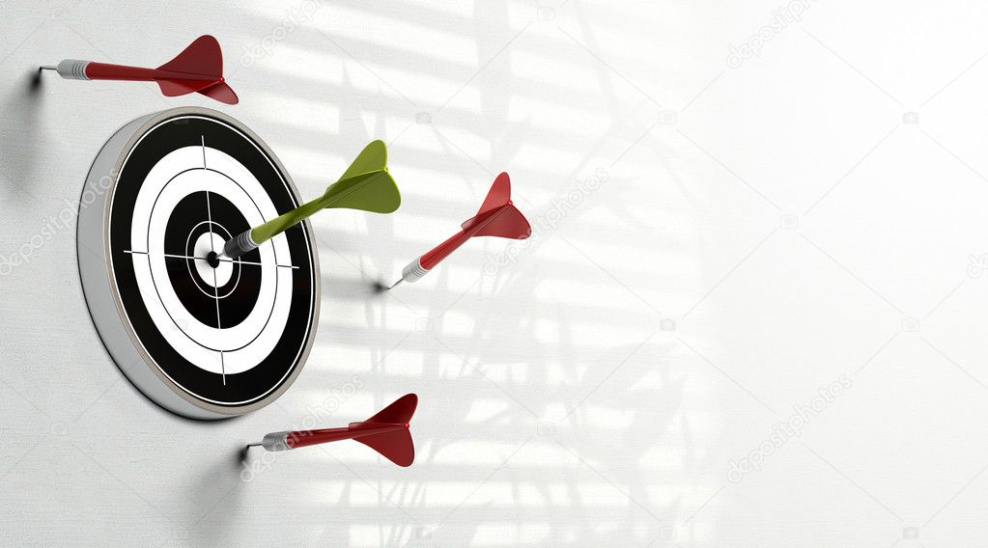
Business Objectives
Our business objective includes providing fast and stable service to customers with flexible prices and excellent customer service.
We expect to profit from our e-commerce site over time and expand the business and the products sold.
We also aim to connect customers with sports and the sports teams they support by buying products related to the team and bringing entertainment, and sports into people’s lives.

Slide 7

S
U
C
C
E
S
S
M
E
T
R
I
C
S
The success of our project is indicated directly by the number of customers getting benefited from the service.
The quality of the products will also have a great impact on achieving success. Making sure customers get the desired product on time and having good connections with the shippers and knowledge of the latest trends affects business directly.
The major achievement would be to provide good and useful products to customers for the price they are happy to pay.
Success is also determined by the margin of profit that is earned

Slide 8

Our goal is to create a solution that makes it easier for sports enthusiasts to find the top sports gear, apparel, and personalized goods for them. Our goal is to make sports easily accessible to everyone.
Customers do not need to visit many websites to search for sports goods since "GoodSports Goods" offers a platform that guarantees all sports goods at low prices.
O
U
R
V
I
S
I
O
N

Slide 9

One of the largest risks to the business would be the competitors in the sporting goods market. These competitors include those who exclusively sell sporting goods, as well as general department stores that sell sporting goods.
Another risk to the business would be whether the demand is there for customizable sporting goods on a large scale.
One other moderate risk for the business would be the speed of manufacturing the custom products and the shipping time to customers.
Business
Risks

Slide 10
Business Assumptions and Dependencies
Assumptions:
The reliance of major sports organizations to allow the use of their intellectual property on our products.
Securing partnerships with other sporting goods makers to customize and sell their products.
The business will likely not be able to create a large range of products independently, so securing agreements to sell other makers’ products would broaden the selection for users.
Having other makers’ products will also draw in customers who are familiar with and enjoy their brand to shop at our business.
Dependencies:
Use shipping services to deliver orders to customers, such as UPS, FedEx, or USPS. Due to the nature of developing an e-commerce website, shipping services are a necessity in order to operate.
Utilization of bank and payment vendors for processing payments. This one is fairly obvious, as e-commerce websites rely on an electronic payment service in order to complete transactions and earn revenue.

Slide 11

Scope And Limitations

Slide 12
Major Features
User-Friendly Navigation
Site Search
Footer Navigation
Product Reviews
Generous Return Policy
FAQ For Products
Order Tracking
Coupon Codes
Product Availability

Slide 13

SCOPE OF INITIAL RELEASE
Some of the major features of ‘GoodSports Goods’ for the initial release include user-friendly navigation, website menu/footer navigation, product reviews, a product return system, and order tracking. We intend our website to help customers navigate and help them have the best shopping experience. The developed characteristics enable users to navigate through the website as well as enable a great interface. This website is built with an intention of being a one-stop shop for all sporting goods to customers.
SCOPE OF SUBSEQUENT RELEASES
Updates made to the website over time will help not only increase the scope of the website, but they will allow for a better user experience. Some of the additional features planned for subsequent releases include a product availability system, a FAQ system for products, and a coupon code system, in order of planned releases.

Slide 14
Limitations
The employee portal is only accessible to employees, using their unique employee ID. If employees enter the incorrect password up to 3 times in a row, the account will get locked and requires IT assistance to re-open.
Product purchases, reviews, questions, and returns can only be done by users who have created an account with the website.
The “filter” feature works based on the details provided by the employees during data entry in the system

Slide 15

BUSINESS CONTEXT

Slide 16

STAKEHOLDERS PRIORITIES

Slide 17
Stakeholder | Major Value | Attitudes | Major Interests | Constraints
Director/ Manager/ CEO | Generate more revenue | Increase in the market share | Better product compared to the competitors | Over Budget Product
IT Team | Ease of functionality with advanced features | Ensuring the security, well- structured functionality and its implementation, appropriate third- party service integration | Proper use of digital infrastructure without any other impact | Development not completed within the given time
Supply Chain Manager | Ensuring the quality, conform to current standards or regulations | Quality control and product shipment | Inventory and delivery are well managed compared to other suppliers | Lack of employees for delivery
Stakeholder | Major Value | Attitudes | Major Interests | Constraints
Director/Manager/CEO | Generate more revenue | Increase in the market share | Better product compared to the competitors | Over Budget Product
IT Team | Ease of functionality with advanced features | ensuring the security, well- structured functionality and its implementation, appropriate third- party service integration | Proper use of digital infrastructure without any other impact | Development not completed within the given time
Supply Chain Manager | Ensuring the quality, conform to current standards or regulations | Quality control and product shipment | Inventory and delivery are well managed compared to other suppliers | Lack of employees for delivery
Marketing & Sales Team | Drive traffic toward the website using various digital marketing strategies | SEO, Email Marketing, Paid Ads, social media marketing | Better discounts, promotions, and rewards compared to other competitors | Lack of building connections, like missing out on famous brands
Operations team | Keep track of goods displayed. | match the inventory and streamline the business process | Automate and optimize the tasks | Mismatch with the goods tracking system
Finance Team | Budget, cost savings and market speculation | operations must be performed within the budget | Proper income statements | Maintain the budget as per the growth
Customers | Good quality at a lower cost | Product Satisfaction | Good and cost-effective service | Feedback is completely ignored

Slide 18
Marketing & Sales Team | Drive traffic toward the website using various digital marketing strategies | SEO, Email Marketing, Paid Ads, social media marketing | Better discounts, promotions, and rewards compared to other competitors | Lack of building connections, like missing out on famous brands
Operations team | Keep track of goods displayed. | Match the inventory and streamline the business process | Automate and optimize the tasks | Mismatch with the goods tracking system
Finance Team | Budget, cost savings and market speculation | operations must be performed within the budget | Proper income statements | Maintain the budget as per the growth
Customers | Good quality at a lower cost | Product Satisfaction | Good and cost-effective service | Feedback is completely ignored

Slide 19
PROJECT PRIORITIES

Slide 20
Dimension | Driver (state objective) | Constraint (state limits) | Degree of Freedom (state allowable range)
Schedule | release 1.0 to be available by 10/1, release 1.1 by 12/1
Features | All functional and non-functional requirements should be satisfied, all features scheduled for above releases should be fully operational |  | Initial release 1.0 should include at least 70% of high priority features
Quality | Test coverage should be at least greater than 98% |  | 92% of user acceptance tests must pass for release 1.0, 96% for release 1.1
Staff |  | Planned team size is 1 P.O., 1 Scrum Master, 3 Developers, 3 Testers
Cost |  |  | budget overrun up to 10% acceptable without sponsor review

Slide 21

Deployment Considerations
In order to establish a successful deployment, there are several considerations that must be taken into account. One important consideration would be the multiple warehouses that will store and create these products across the country. If we are to appeal to the entirety of the U.S. market, it would not be ideal to have only one location for the product shipment. Having multiple warehouses would greatly reduce shipping times for various parts of the U.S. As such, employees will also need to be located at these warehouses for proper operation. Employees there will have to be responsible for fulfilling orders, keeping inventory of products, and maintaining communication with other warehouses and the company. These tasks will be supported and maintained with the use of internal and external systems. These systems will also require database storage to properly log the records of each warehouse.

Slide 22



